Slide 1
Our Point of View Use of Generative AI

Slide 2
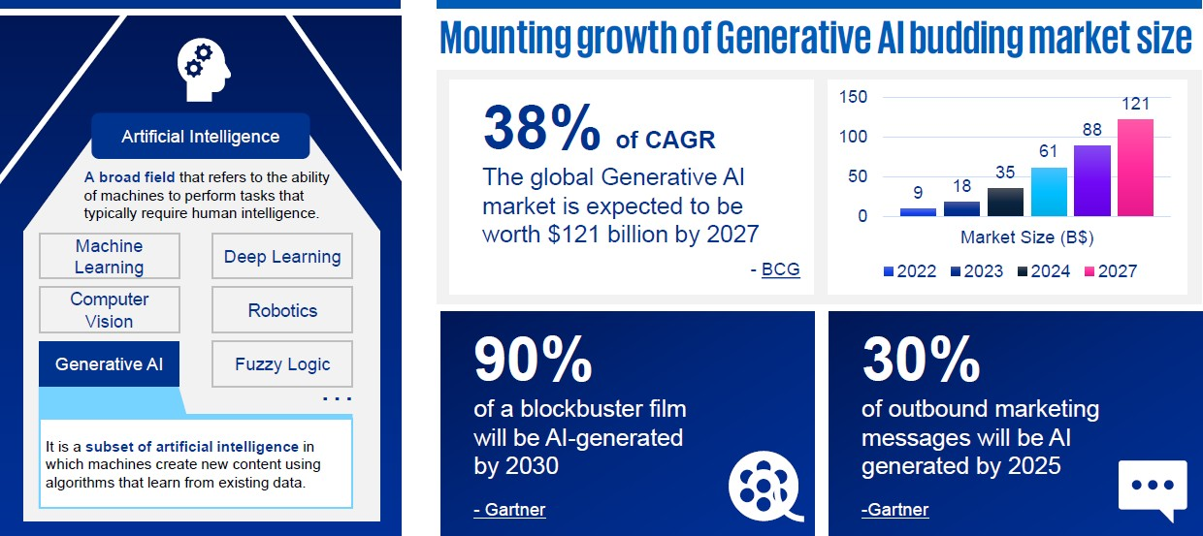
Decrypting the meaning and potential of Generative AI

Slide 3





How do we leverage Generative AI capabilities?
Five broad capabilities of Gen AI
Information Extractors
Summarize and analyze larger documents, in short- and long-form.
Content Generators
Generative tools which can generate blog posts, emails, images etc.
Digital Assistants
Virtual assistants that can interact conversationally, based on defined logic.
Language Translators
Tools to translate into multiple languages, as well as build out content.
Code Generators
Convert text inputs into code in various programming languages.
Business KPI Generation
Reports Generation
Email content Generation
PDF Generation
Images Generation
Video Generation
Music Generation
Data Extraction
Feature Extraction
Terms & Condition Extraction
Contract Extraction
Table Extraction
Summarization
Smart Chatbots
Knowledge Miner
Translating the language from English to any other language
SQL code
Python code
Code Reviewer
Use cases

Slide 4








Typical Gen AI use cases for the Enterprise
Functions
Marketing
Sales
Customer Support
Customer Success
Legal
Risk
Human Resources
Tech/
Engineering
Personalized offers for each customer
Personalized sale pitch generation
Virtual assistants
Customer Segmentation
Legal document review and synthesis to extract key points
Fraud detection
Conversational Assistant for employee knowledge management
Generate/
Complete / review / document code
Gen AI Use Cases
White paper, blogs commercial, and ad writing
Demos tailored to customer environment
Auto-generated user guides & tutorials
Account profile generation to find upsell opportunities
Convert colloquial languages into English
Customer risk and market risk
Virtual recruiter for sourcing, interviewing, and screening
Metadata creation of data tables
Visual marketing material generation
Client outreach email writing
Product recommendations
Customer sentiment and experience management
Contract creation and review
Regulatory compliance
Workforce training and job simulation
Translate/ transform data and programming code
Benefits
10x
Faster Content Generation
60%
Reduction in costs
40%
Increase in productivity
12%
Net Revenue Retention Increase
35-60%
Increase in Productivity
15%
Reduction in risk exposure
55%
Support issues can be resolved end-to-end
90%
Developers are faster with repetitive tasks

Slide 5

Reshape work in the finance function with AI and Gen AI
Financial Planning & Analysis
Controllership & Finance Operations
Finance Business Partnering
Tax Management
Treasury and Financial Risk Management
Investor Relations
POTENTIAL AI & GEN- AI INTERVENTIONS
Digitally enabled Financial planning & analysis
Faster, Improved & automated control functions
AI based Smart assistants for partnering…
Improved Tax Analysis by using large language models...
Improved Cash visibility and measure exposure
AI managed investor Relations
Finding external variables for budgeting & forecasting
Rear view Monitor
Capex Auditing
Spend Classification
Forward Looking Analysis
Cashflow Forecasting
Revenue Forecasting
Payables Forecasting
Delayed Payments and Collections Predictions
Dispute likelihood
Anomaly detection
( for risk identification )
Credit Reviews For Customers
NLP based extraction for
Capex Auditing
Contract Information for compliance checks
Assisting with Audit trails
Digital Process / Task Discovery
Reports / document generation for respective business partners
Digital Assistant for business partners to explain their unit’s performance
Information Extraction from Documents & Images (OCR)
Anomaly Detection
Pattern recognition for leakage identification
Cashflow Forecasts
Consolidated Information extraction from multiple Bank statements
Limits Monitoring and Forex Variance
Fraud Detection
Reference Document Search
Information Summarization - Drafting responses for Investor Relation Calls
Digital assistants for Stakeholders

Slide 6
Use Cases for Gen AI developed by KPMG
Domain
Business Analytics
Audit and Tax
Customer Success
Legal
Human Resources
Tech/
Engineering
Intelligent Data Analytics
Compliance Checklist generator (Audit)
Customer Feedback Analysis
Contract creation and review
AI driven hiring
Master Data Management
Gen AI Use Cases
Data Miner (on Text + Video + Audio Documents)
Multi-lingual chatbot
Training flash card generator
IT Service Now Bot
Tax report summarization
Vendor Name matching
Customer sentiment
Employee leave application
Material Name matching and consolidation

Slide 7
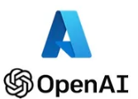












Illustrative Architecture to enable Gen AI on Azure
Data Sources
Azure AI Document Intelligence
Preprocess
Store
Return the context from the documents
Store embeddings
Language model
(embeddings)
4
Words, phrases to search in vector format
Company knowledge documents (contracts, FAQs, etc..)
Form Recognizer
Doc chunking
Vector Database
SQL/Python Code Generation
User query
Language Model
Company Internal Dataset
Data Cleaning, Transformation , Metadata Dictionary, KPI Dictionary
Internal Data
Model memory (LangChain)
User
Azure Data Lake
Answer
Web Datasets
Bing Search language model
Governance & Security

